Slide 1
Deadlocks In Mulled
Vaibhav Shah

Slide 2
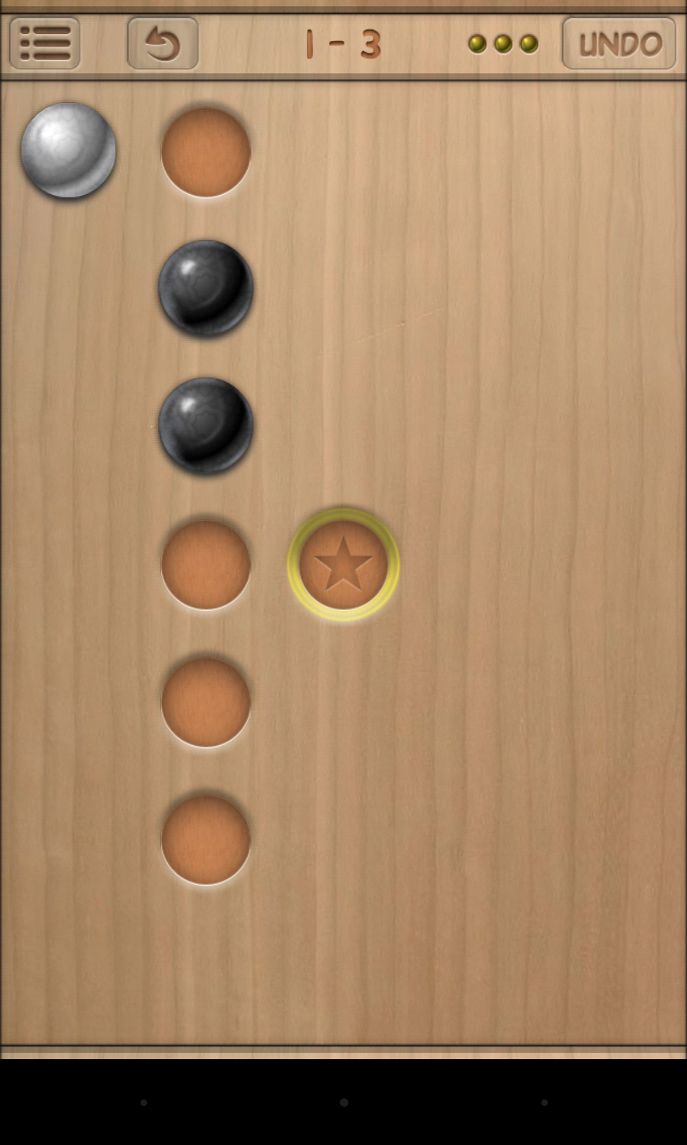
Details about the Game(Mulled)
Objective:- Position the White ball on the goal position in minimum number of steps.
Rules:-
Only White ball can be moved in one of the 4 directions by one step at a time if it’s a legal move.
Black balls cannot be moved directly but they can be pushed with the help of white ball.

Slide 3

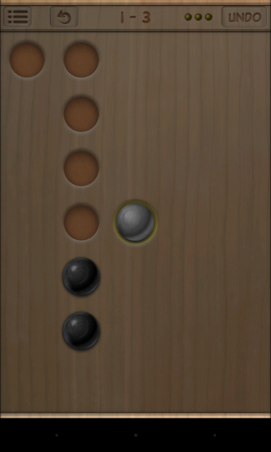
Problem Space Model
Set of States:- A physical configuration of the puzzle.
Operators:- 4 of them namely Left, Right, Up and Down.
Initial State:- White and black balls placed at random positions with one position marked as Goal.
Goal State:- White ball is positioned on the goal position.
Initial State
Goal State

Slide 4
Solving the Puzzle
Approach 1:- Using Breadth-First Search(BFS)
Was able to solve initial states upto around 100 cells in minutes.
Gave Out of Memory error and took too much time for states with more than 100 cells.
Approach 2:- Using A*
Easily able to solve initial states of 200 cells in not more than a minute.
Very fast and efficient as compared to BFS.

Slide 5
Deadlocks
States from which reaching the goal becomes impossible.
In Mulled, it is easy to push black balls but much harder to pull them back.
Thus the level can get “deadlocked” meaning the level isn’t solvable anymore.
Only way out is to undo a movement or to restart the level.

Slide 6
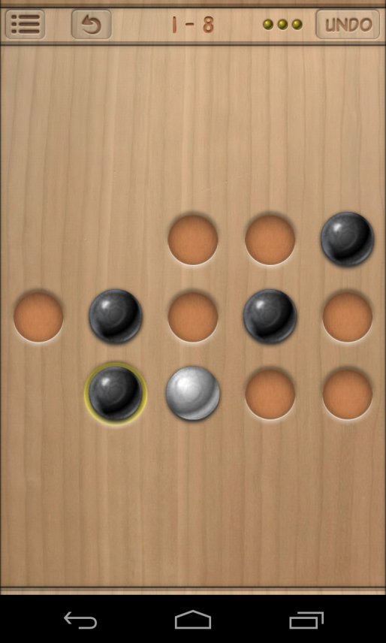
Deadlock 1 – Simple Deadlock
Black ball gets positioned on the goal position such that it is immovable in both the directions.
Avoidance
Original Rule:- Move in a direction if there is an Available or a Goal cell in that direction.
Restricted Rule:- Only move in a direction if there is an Available cell or if the Goal cell is adjacent to the white ball.
Also implemented a function to check for the immovability of black ball on goal.
.

Slide 7
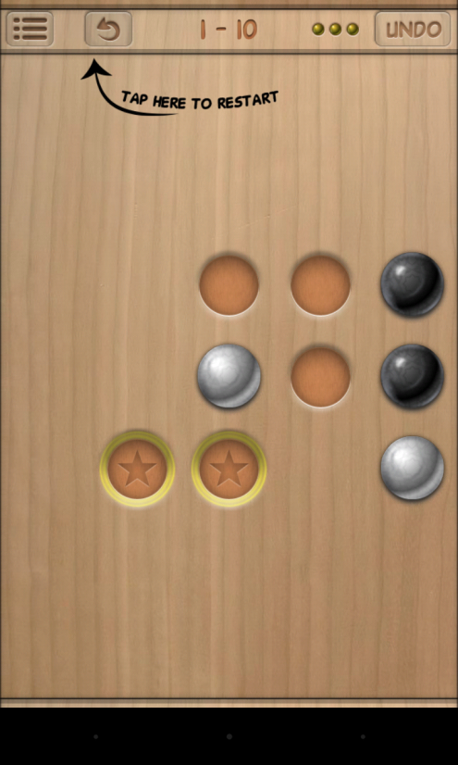
Deadlock 2 – Freeze Deadlock
White ball gets placed into a cell such that no legal moves are allowed.
Generally occurs when dealing with multiple white balls.
Not possible with just one white ball unless the initial state already has this deadlock.

Slide 8
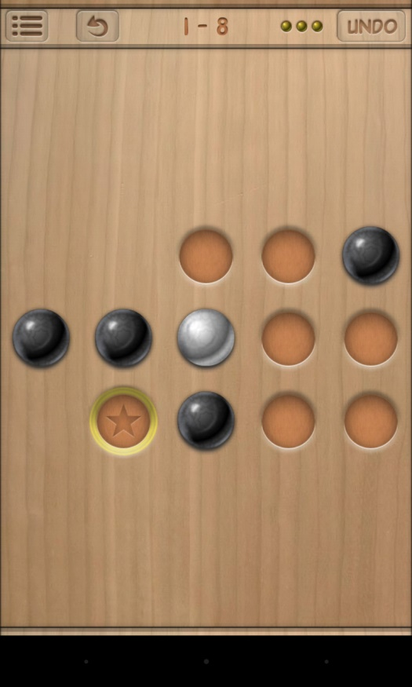
Deadlock 3 – Blocked Goal Deadlock
All legal neighbors of goal cell are occupied by black balls such that these black balls cannot be moved in any direction except towards the goal which will create deadlock 1.
Avoidance:-
Implemented a function for testing the immovability of black balls surrounding the goal.
Function includes normal checking of available cells in horizontal and vertical direction and hence it involves cheap computation.

Slide 9
Comparison
Number of cells | # of nodes evaluated by BFS | # of nodes evaluated by A* | # of nodes evaluated by A* with deadlock search | Number of deadlocks identified
4 | 3 | 3 | 3 | 0
5 | 3 | 3 | 3 | 0
10 | 5 | 5 | 5 | 0
15 | 9 | 8 | 8 | 0
24 | 12 | 9 | 9 | 0
24 (Unsolvable) | 28 | 28 | 13 | 2
48 | 507 | 68 | 61 | 2
96 | 371178 | 2060 | 790 | 24
160 | Memory Error | 633 | 496 | 2
192 | Memory Error | 2924 | 1458 | 75

Slide 10
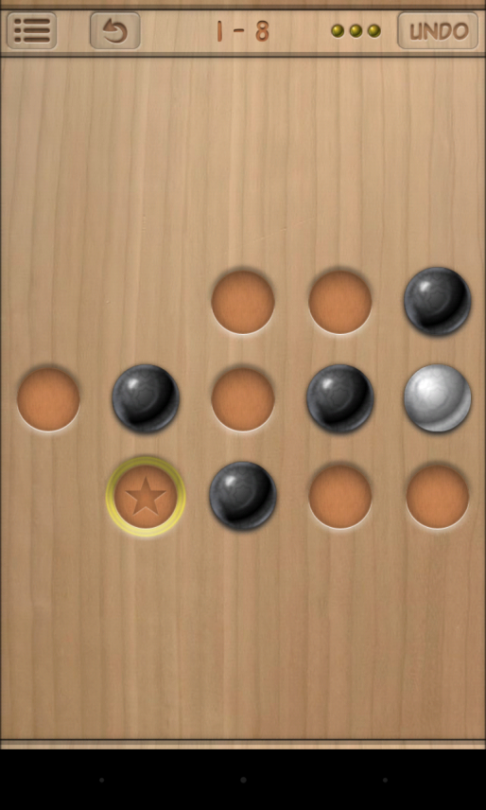
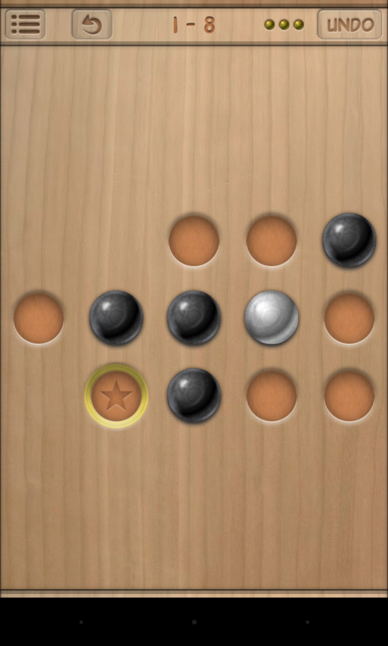
Minimin Lookahead Search
Solvable Unsolvable
Given a minimum search horizon equal to the maximum of the number of black balls positioned on the two shortest paths between the white ball and goal position plus one; deadlocks can be avoided so that you won’t make the level unsolvable given a solvable state.

Slide 11
References
Cazenave, Tristan, and Nicolas Jouandeau. "Towards deadlock free Sokoban." (2010).
http://sokobano.de/wiki
Junghanns, Andreas, and Jonathan Schaeffer. "Sokoban: Evaluating standard single-agent search techniques in the presence of deadlock." Advances in Artificial Intelligence. Springer Berlin Heidelberg, 1998. 1-15.

Slide 12
Thank You
Questions?
Comments?
Suggestions?

